Slide 1
Create engaging messages with Adaptive Cards
Use Adaptive Cards in Microsoft Teams apps and conversations

Slide 2

Overview
Adaptive Cards in Microsoft Teams
Task modules
Bots
Messaging extensions

Slide 3
Adaptive Cards in Microsoft Teams
Microsoft Teams supports Adaptive Cards in many custom app extensibility points
Task modules
Bots
Messaging extensions
Notes:
Developers building custom apps for Microsoft Teams can use adaptive cards in various extensibility points. Some of these options include the following:
- **Task modules**: Dialogs in Microsoft Teams are implemented as task modules. A task module can be either a web page loaded within an Iframe, or an Adaptive Card.
- **Bots**: Conversational bots built using the Microsoft Bot Framework can reply to messages or sent proactive messages as a text-based message or as an Adaptive Card.
- **Messaging extensions**: Messaging extensions can pre-fill or add content to a new or existing message. This content can be in the for of a text-based message or an Adaptive Card.

Slide 4
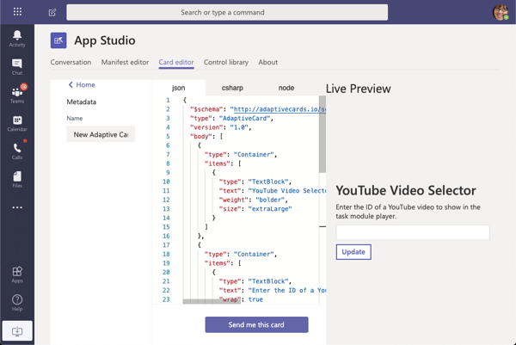
Creating Adaptive Cards with App Studio

Slide 5
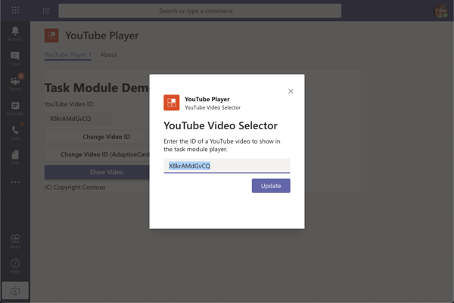
Use Adaptive Cards with Task Modules
Using Adaptive cards with task modules is similar to using web pages
Task module web pages require setting the the url of the web page
To use an Adaptive cards the card JSON to the card property on the TaskModuleTaskInfo object
Notes:
Task modules are dialogs in Microsoft Teams. Developers have the option to implement task modules in one of two ways:
- **IFramed web page**: A task module can point to a URL of an HTML page that is rendered in an Iframe in the task module popup window.
- **Adaptive Card**: A task module can render an Adaptive Card in the contents of hte task module popup window.
Using Adaptive Cards in task modules follows nearly all the same requirements as a HTML-based task module.

Slide 6
Use Adaptive Cards with Task Modules
// load adaptive card
const adaptiveCard: any = require("./YouTubeSelectorCard.json");
const taskModuleInfo = {
title: "YouTube Video Selector",
card: adaptiveCard,
width: 350,
height: 250
};
const submitHandler = (err: string, result: any): void => { };
microsoftTeams.tasks.startTask(taskModuleInfo, submitHandler);
Notes:
One difference is how you create the task module. Task modules are invoked by passing a populated instance of the `taskInfo` object in the `microsoftTeams.tasks.startTask()` method. For an HTML-based task module, you set the address of the web page loaded in the task module in the `taskInfo.url` property.
When using an Adaptive Card, you assign the JSON of the card to the `taskInfo.card` property.
Another difference with Adaptive Cards is in the parameter of the callback method defined when invoking the task module with the `startTask()` method. The values of all input controls defined in the Adaptive Card are returned in a single object, `result`, in the callback method.

Slide 7
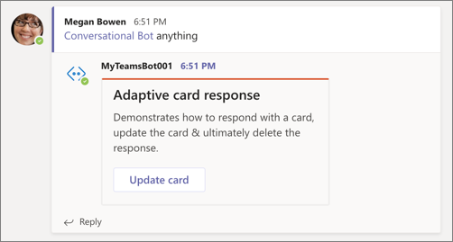
Use Adaptive Cards with Bots
Bots are web services, hosted by the provider and connected to Microsoft Teams via the Microsoft Bot Framework
Bots send/reply to messages to/from Microsoft Teams via the Bot Framework
Messages cane be one of two types:
Text-based
Adaptive Card
Notes:
Conversational bots in Microsoft Teams are implemented using the Microsoft Bot Framework. The bot is a web service that's registered with the Microsoft Bot Framework and has the Microsoft Teams channel enabled.
Your custom web service that sends replies and messages to Microsoft Teams can send text-based messages or messages as Adaptive Cards. The message is sent via the Bot Framework to Microsoft Teams that knows how to render each type of message.

Slide 8
Send messages as Adaptive Cards from bots
export class MyBot extends TeamsActivityHandler {
constructor() {
super();
this.onTeamsChannelCreatedEvent(async (channelInfo: ChannelInfo, teamInfo: TeamInfo, turnContext: TurnContext, next: () => Promise<void>): Promise<void> => {
const card = CardFactory.adaptiveCard({..});
const message = MessageFactory.attachment(card);
await turnContext.sendActivity(message);
await next();
});
}
}
Notes:
The following code demonstrates sending a message to a newly created channel when the channel is created:

Slide 9
Update existing messages
export class ConvoBot extends TeamsActivityHandler {
private async updateCardActivity(context): Promise<void> {
const data = context.activity.value;
data.count += 1;
const card = CardFactory.adaptiveCard({..});
await context.updateActivity({
attachments: [card], id: context.activity.replyToId, type: 'message' }
);
} }
Notes:
Bots can also update messages they created. The update can replace an existing Adaptive Card, similar to how Outlook Actionable Messages can be refreshed.
The following code demonstrates how to update an existing message. The `replyToId` property on the activity that initiated the turn, use the `updateActivity()` method to update an existing message.

Slide 10
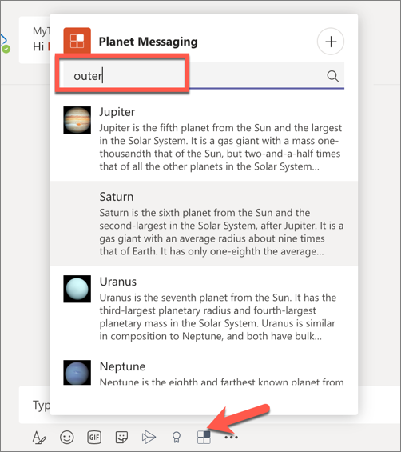
Use Adaptive Cards in Messaging Extensions
Action commands enable users to search an external system for information
Search query is sent from Microsoft Teams to your web service
Your web service responds with a list or grid of results
When a user selects a result, it is added to the compose message box as a card or text
Notes:
Messaging extensions in Microsoft Teams enable developers to pre-fill or update a message by searching for content in an external system (*search commands*) or perform an action (*action commands*).
Adaptive Cards can be used in both types of messaging extension command types.
Search commands are used from the compose box at the bottom of the Microsoft Teams client. Either through an @mention, or by selecting the extension's icon, the user can search an external system. The search results are returned as Adaptive Cards:

Slide 11
Respond to search command queries
export class PlanetBot extends TeamsActivityHandler {
protected handleTeamsMessagingExtensionQuery(context, query): Promise<MessagingExtensionResponse> {
// get the search query
let searchQuery = query.parameters[0].value.trim().toLowerCase();
// execute search logic
let queryResults: string[] = ...;
// get results as cards
let cards: MessagingExtensionAttachment[] = [];
queryResults.forEach((planet) => {
cards.push(this.getPlanetResultCard(planet));
});
let response: MessagingExtensionResponse = <MessagingExtensionResponse>{
composeExtension: { type: "result", attachmentLayout: "list", attachments: cards } };
return Promise.resolve(response);
} }
Notes:
When your search action is invoked, the Bot Framework will send an `Activity` object to your web service of type `composeExtension/query` with the command id that you need to respond to with an object containing a `composeExtension` object within five seconds of receiving the request.
The method `handleTeamsMessagingExtensionQuery()` is called by the Bot Framework SDK when a message of type `composeExtension/query` is received.
The `attachmentLayout` property can be either a `list` of results containing thumbnails, titles and text fields, or a `grid` of thumbnail images.
The `attachments` property is used when `type` is set to `result` and contains an array of supported cards.

Slide 12
Demo

Slide 13
Thank you

